Slide 1
Class Task -2 Solution

Slide 2

Task
Construct CFG that generates the language L = {w $∈$ {a,b}*: length(w) $≥$ 2 and second letter of w from right is a}

Slide 3
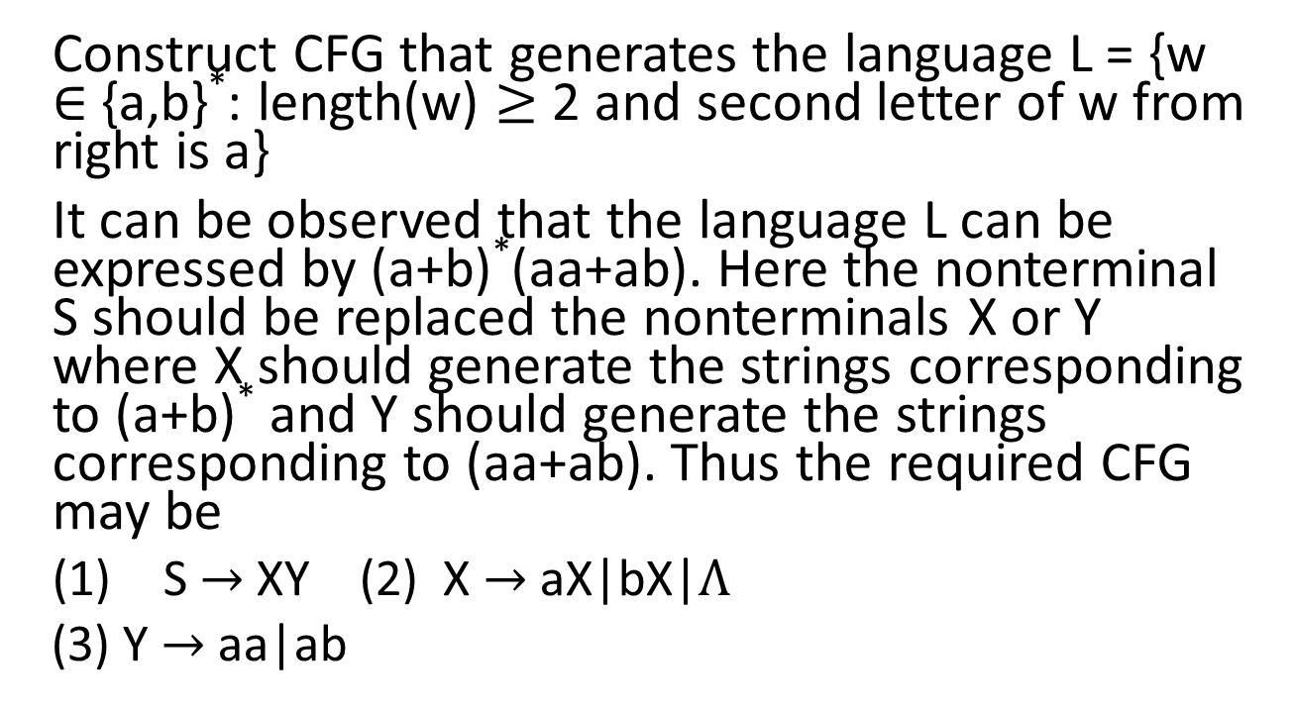
Solution of the task
Construct CFG that generates the language L = {w $∈$ {a,b}*: length(w) $≥$ 2 and second letter of w from right is a}
It can be observed that the language L can be expressed by (a+b)*(aa+ab). Here the nonterminal S should be replaced the nonterminals X or Y where X should generate the strings corresponding to (a+b)* and Y should generate the strings corresponding to (aa+ab). Thus the required CFG may be
(1) S $→$ XY (2) X $→$ aX|bX|$Λ$
(3) Y $→$ aa|ab

Slide 4
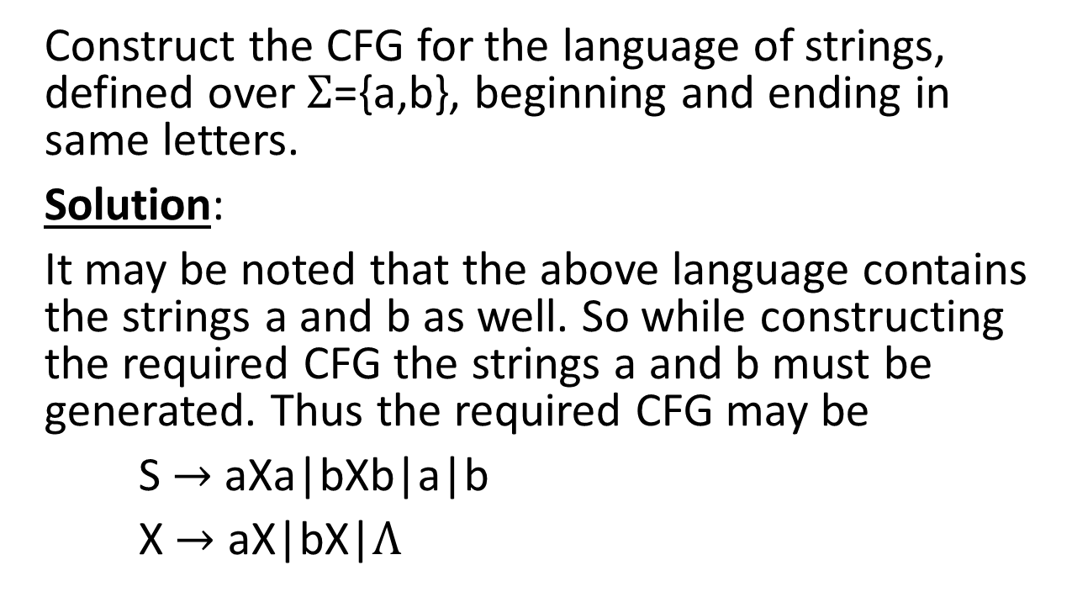
Task
Construct the CFG for the language of strings, defined over $Σ$={a,b}, beginning and ending in same letters.
Solution:
It may be noted that the above language contains the strings a and b as well. So while constructing the required CFG the strings a and b must be generated. Thus the required CFG may be
S $→$ aXa|bXb|a|b
X $→$ aX|bX|$Λ$

Slide 5
Solution of the Task
Convert the following infix expressions into the corresponding prefix expressions. Calculate the values of the expressions as well
2*(3+4)*5
Solution: 2*+3 4 *5 which can be calculated as
*2+3 4 *5 = * *2+3 4 5= **2 7 5 = *14 5 = 70
((4+5)*6)+4
Solution: (+4 5 * 6)+4= (*+4 5 6) + 4 which can be calculated as
+*+4 5 6 4 = +* 9 6 4 = +54 4 = 58

